Slide 1

CHAPTER 8
Hypothesis Testing
DISCOVER . LEARN . EMPOWER

Slide 2
INDEX
Tests of Significance based on normal distributions
t distributions
chi-square distributions
Analysis of variance techniques

Slide 3

Tests of Significance based on normal distributions
In probability and statistics, the normal distribution or Gaussian distribution or bell curve is one of the most important continuous probability distributions.
The normal distribution is defined as the probability density function f(x) for the continuous random variable, say x, in the system.
Where
μ = Mean
σ = Standard deviation
x = Normal random variable

Slide 4
Hypothesis Testing
Hypothesis Testing is a type of statistical analysis in which you put your assumptions about a population parameter to the test.
It is used to estimate the relationship between 2 statistical variables.
Z = ( x̅ – μ0 ) / (σ /√n)
Here, x̅ is the sample mean,
μ0 is the population mean,
σ is the standard deviation,
n is the sample size.

Slide 5
Types of Hypothesis Testing
Z Test
T Test
Chi-Square

Slide 6
T-Test
A t-test is an inferential statistic used to determine if there is a statistically significant difference between the means of two variables.
The t-test is a test used for hypothesis testing in statistics.
Calculating a t-test requires three fundamental data values including the difference between the mean values from each data set, the standard deviation of each group, and the number of data values.
T-tests can be dependent or independent.

Slide 7
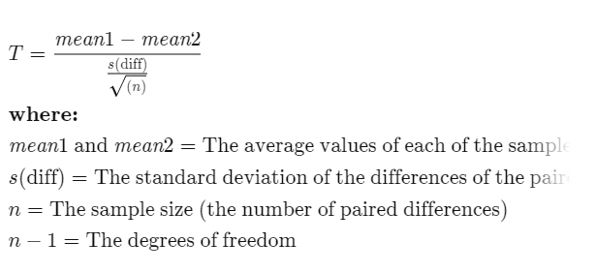
Paired Sample T-Test
The correlated t-test, or paired t-test, is a dependent type of test and is performed when the samples consist of matched pairs of similar units, or when there are cases of repeated measures.

Slide 8
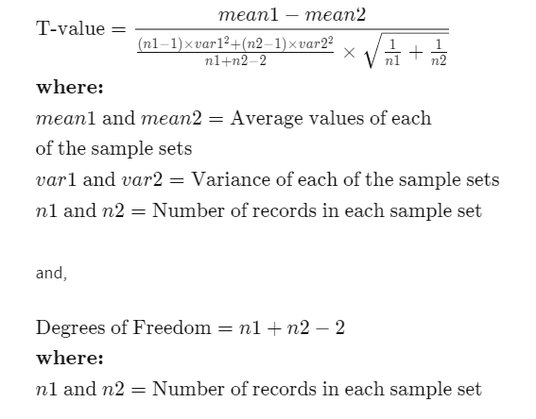
Equal Variance or Pooled T-Test
The equal variance t-test is an independent t-test and is used when the number of samples in each group is the same, or the variance of the two data sets is similar.

Slide 9
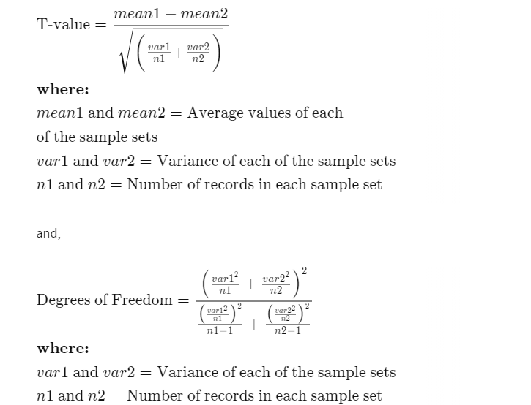
Unequal Variance T-Test
The unequal variance t-test is an independent t-test and is used when the number of samples in each group is different, and the variance of the two data sets is also different. This test is also called Welch's t-test.

Slide 10
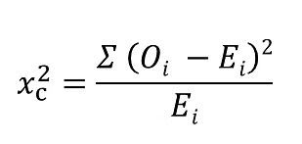
Chi-Square Test
A chi-square test is a statistical test that is used to compare observed and expected results.
The goal of this test is to identify whether a disparity between actual and predicted data is due to chance or to a link between the variables under consideration.
Where
c = Degrees of freedom
O = Observed Value
E = Expected Value

Slide 11

Analysis of variance techniques
Analysis of Variance (ANOVA) is a collection of statistical models used to analyze the differences between group means or variances.
Compares multiple groups at one time.

Slide 12
One way ANOVA
Compares two or more unmatched groups when data are categorized in one factor.
Example :
Comparing a control group with three different doses of aspirin
Two way ANOVA
Used to determine the effect of two nominal predictor variables on a continuous outcome variable.
It analyses the effect of the independent variables on the expected outcome along with their relationship to the outcome itself.

